Slide 1
Who is afraid of inflation:
The politics of austerity and the long shadow of the 1970s
Adam Tooze Yale
September 2013

Slide 2
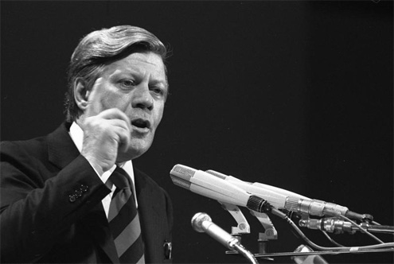
Helmut Schmidt, Dortmund, Juli 1972: “lieber 5 prozent inflation als 5 prozent arbeitslosigkeit” “rather 5 percent inflation than 5 % unemployment”

Slide 3
Agenda for the talk:
Critique of left anti-inflationism, anti-Streeck
A useable history of the 1970s
Alternative future histories of the recovery: austerity, managed inflation, inflationary conflict

Slide 4
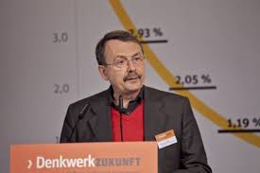
Wolfgang Streeck, Buying Time. The Crisis of Capitalism Postponed

Slide 5
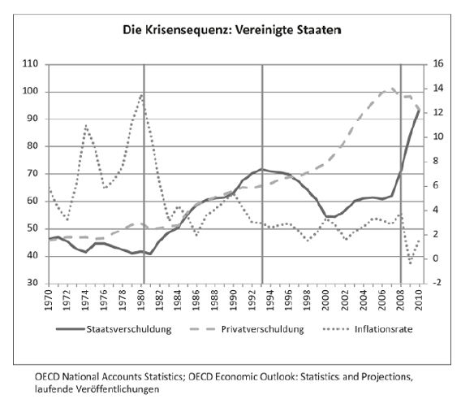
Streeck’s “crisis sequence” paradigm is based on the US: Inflation, public debt, privatized Keynesianism

Slide 6
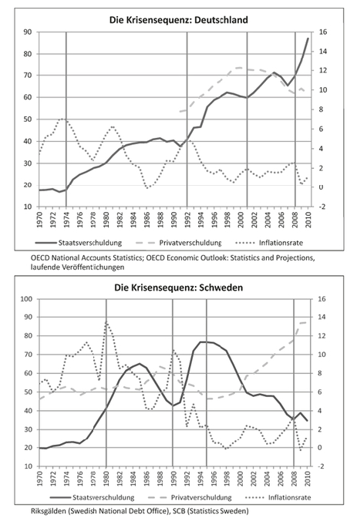
Streeck wants to see this as a generic, common pattern, repeated in each major national economy.
Whereas in fact what we need is an account of the build-up of macroeconomic imbalances as expression of uneven and combined development of global capitalism

Slide 7
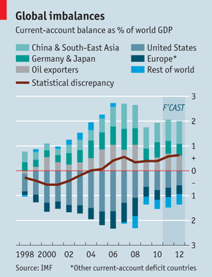
If some are buying time, who is selling?

Slide 8
Tensions in Streeck’s work
Describes EURO as a reborn gold standard …
rather than a fiat currency zone with a willfully conservative policy stance
In favor of devaluation …
… but against inflation
In favor of debt jubilees
… but against inflations
… but against inflationary disorder
In favor of organized labor
… but against the political disorder unleashed by inflation
In favor of protest
Unwilling to countenance a return to the 1970s
… but keen to draw inspiration from Bretton Woods

Slide 9
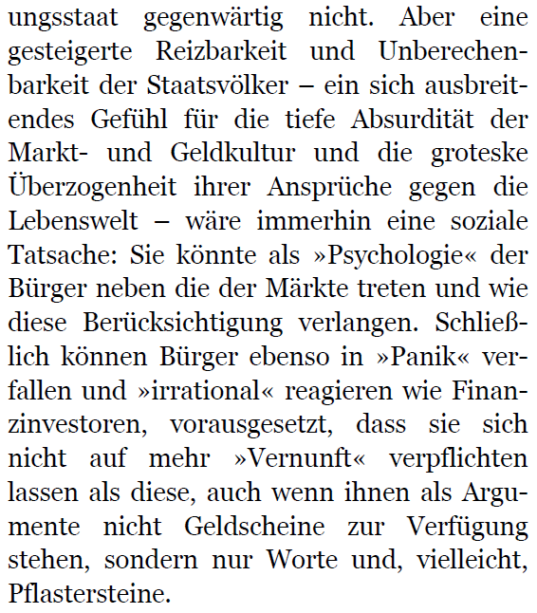
Streeck, Gekaufte Zeit, 224.
Streeck on the need for the right of the citizenry to panic like the financial markets

Slide 10
Helmut Schmidt, Dortmund, Juli 1972: “lieber 5 prozent inflation als 5 prozent arbeitslosigkeit”

Slide 11
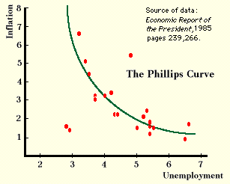
What makes Schmidt’s 1972 speech possible?
Audience – organized working-class that had put the SPD in office
2. Collapse of Bretton Woods
3. Belief that there was a trade off
4. Belief that as finance Minister he had power to make the call – rather than Bundesbank

Slide 12
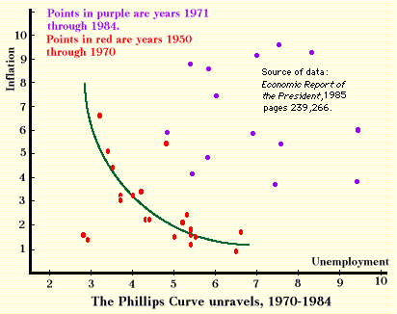
Just over ten years later …
1. Trade off has collapsed … from Philips curve to NAIRU (non-accelerating rate of unemployment
2. Schmidt out of power and old left fragmenting irrevocably
3. Bundesbank calling shots both at home …
4. Bretton Woods replaced by european monetary system

Slide 13
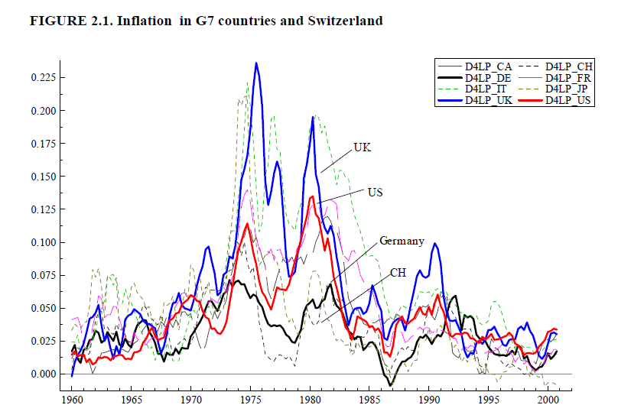
A new German Sonderweg defined during the “great inflation”: 1973-1983

Slide 14
But this special path is, at first, not exemplary. It puts Germany on the defensive.
Contrary to simplistic narrative of “market revolution” in economics, Keynesianism does not give up without a fight!

Slide 15
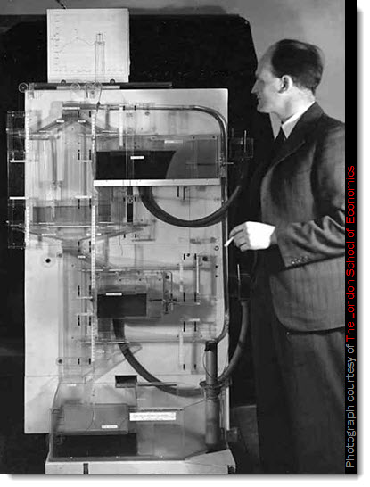
The caricature of mechanical Keynesianism
Bill Phillips LSE, 1949
Money National Income Analogue Computer
MNIAC

Slide 16
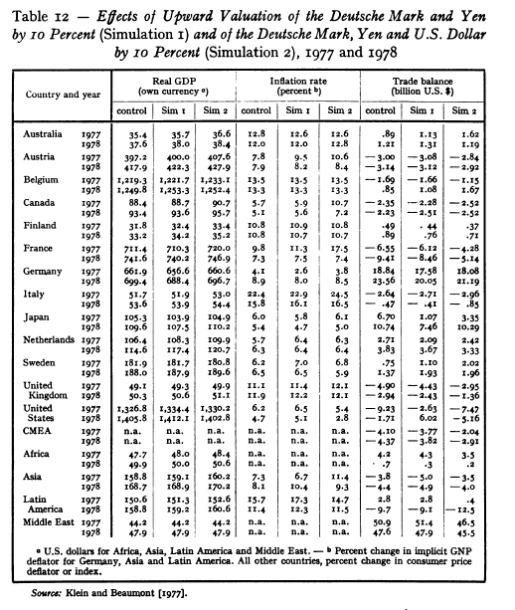
1970s High-Tech the Econometric Matrix of the locomotive theory: interdependencies estimated as part of the OECD/UN LINK model, 1978

Slide 17
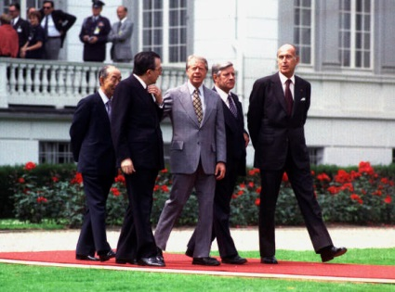
Organized informality : Bonn Economic Summit 1978

Slide 18
Decisive Junctures in the Establishment of the Anti-Inflationary Order
March 1978 Preliminary Franco-German-Commission talks about EMS
June 1978 Bonn Summit
30 Nov 1978 Schmidt compromise with the Bundesbank over EMS
Oct 1979 Carter appoints Volcker to Fed
Dec 1980 $ Reserves of Bundesbank fallen by half since 1978
Feb 1981 $ interest rates reach maximum of 21 %
19 Feb 1981 Bundesbank responds by raising rates
1 April 1981 German and French governments negotiate with Saudis
11 Mai 1981 Mitterand elected French President
22 Mai 1981 Capital Controls introduced in France
5 Oct 1981 1st devaluation of Franc in EMS
Juni 1982 Fiasco of Paris Economic Summit
12 Juni 1982 2nd Franc devaluation
March 1983 Collapse of socialist-communist coalition in Paris

Slide 19
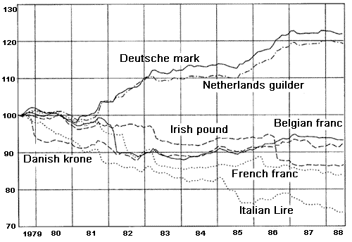
The German dominated EMS:

Slide 20
1978-1983 as a historic juncture
1. Direction of Fed policy set down to the present
2. Schmidt’s compromise with the Bundesbank sets tone of Eurozone the largest economic unit in the world:
Iron triangle of geopolitical concern, “coming to terms with the past” and monetary/fiscal austerity
3. France is the last “experiment” by a major capitalist economy. It is french officials who generalize what becomes known as Washington consensus

Slide 21
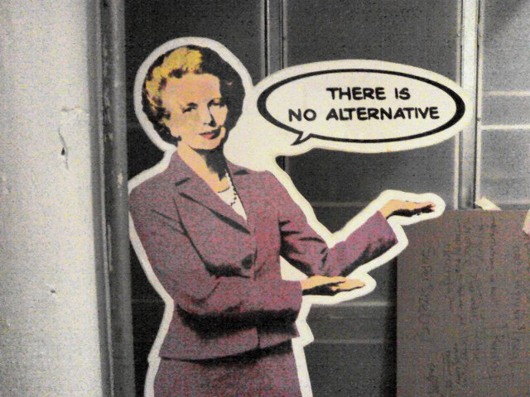
By revisiting the history of the 1970s and recasting it as a story of dramatic political struggle and open debate we may hope to puncture the complacent determinism of the “great moderation” story.
Can we counteract the tendency for TINA to morph into TWNA (There was no alternative)

Slide 22
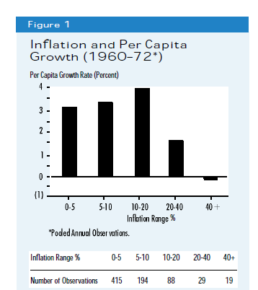
In the “golden age”, growth and inflation had been positively associated.

Slide 23
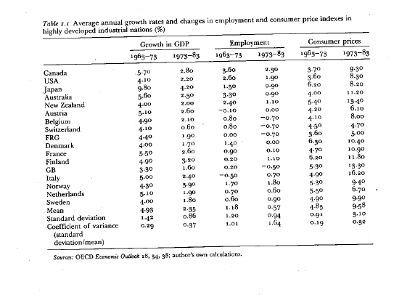
The disappointing balance of a deflationary decade:

Slide 24
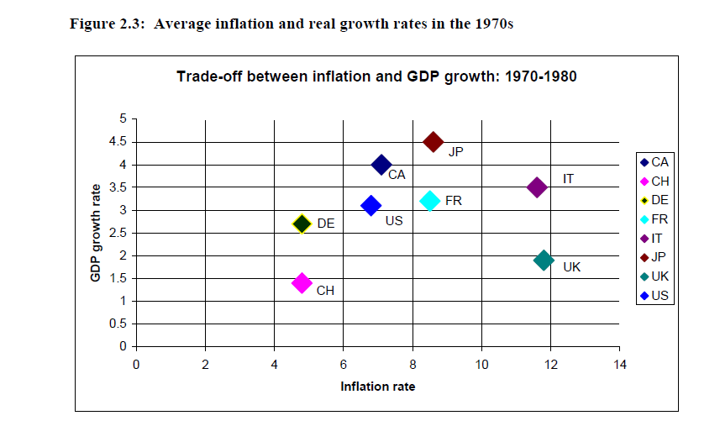
Was Low Inflation Really Good for Growth?

Slide 25
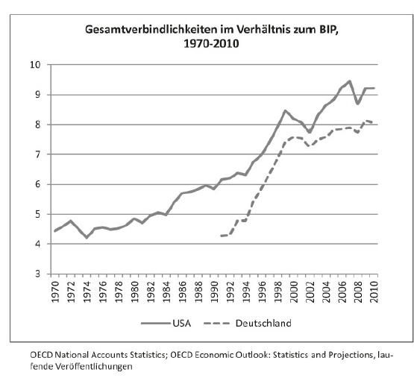
If moderate inflation is not bad for growth, what might it be good for?
Total Liabilities in Relation to GDP: USA and FRG

Slide 26
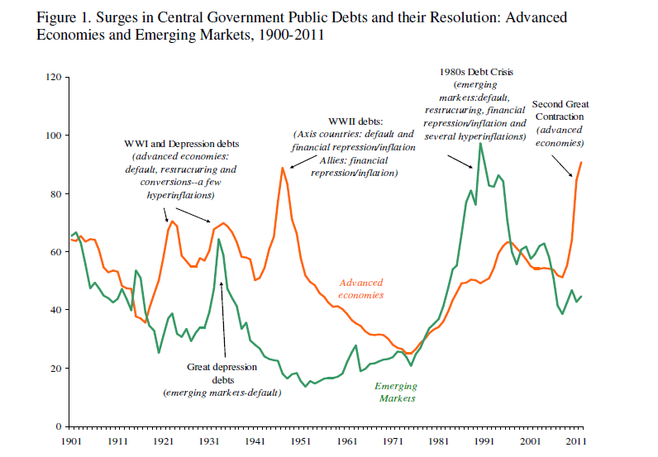
Slaying the inflationary demons for good? An austere future of debt repayment without historical precedent.

Slide 27
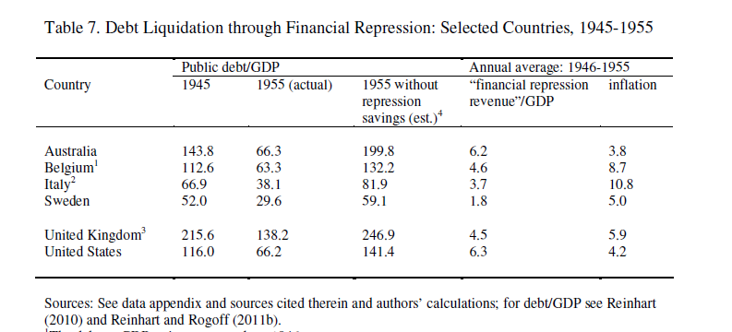
Rewriting the first ten of the trente glorieuse: the effect of inflation in reducing real postwar debts 1945-1955

Slide 28
Can we have an inflationary policy?
1. Is it equivalent to “pushing on a string”? i.e. can we get investment to revive?
Is a policy of austerity more or less likely to revive animal spirits?
2. Can we manage an inflation once it is going?

Slide 29
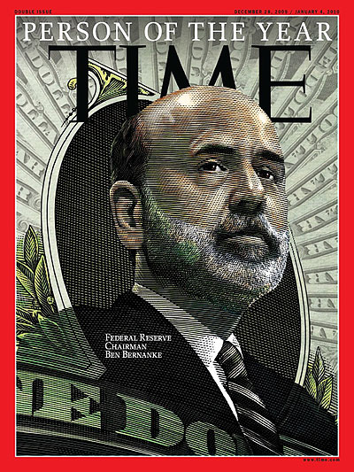
If the central bankers do manage an upward revision in inflationary targets and stick to them ….
→ It will be the greatest technocratic success story in history

Slide 30
We will need to reevaluate the pessimistic stories of policy failure told since the 1970s.
We will need to reevaluate the story evoked by the shattering of the Philips Curve

Slide 31
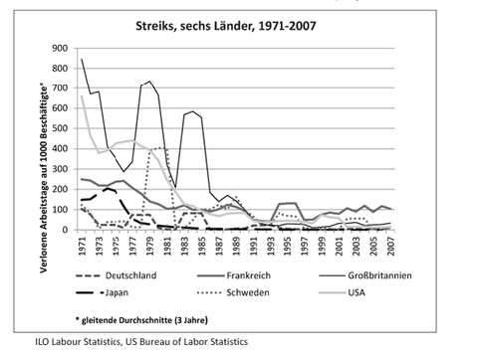
But what if the 1970s repeat themselves and inflation proves hard to control …. →
Inflationary momentum may build up. But what will be the social forces that drive the escalating inflation?
Unemployment is selective. The Cost of Living Is Felt by Everyone.

Slide 32
To Streeck’s Adorno Lectures let us reply with a paraphrase of Horkheimer’s famous injunction about capitalism and fascism:
“Whoever wishes not to speak of inflation ….
…. should be silent about debt jubilees and a new politics of redistribution”

