Slide 1
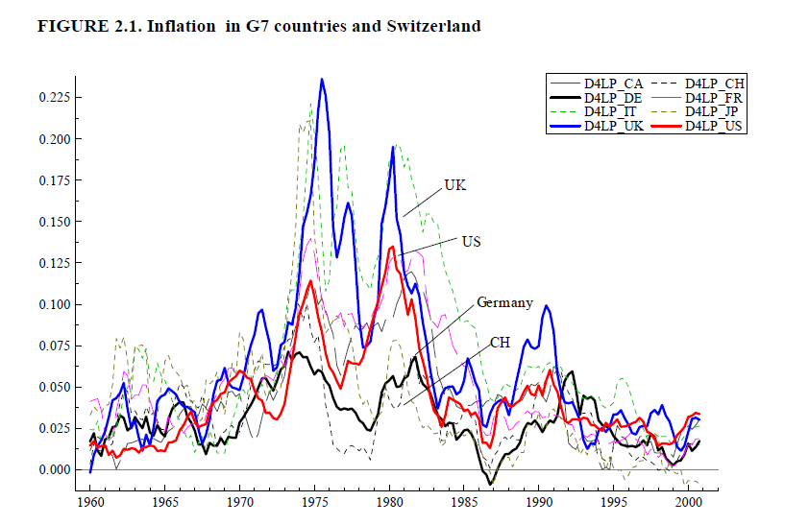

Slide 2
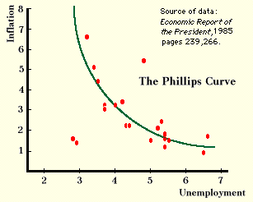
Phillips curve estimated on US data, 1950-1970

Slide 3
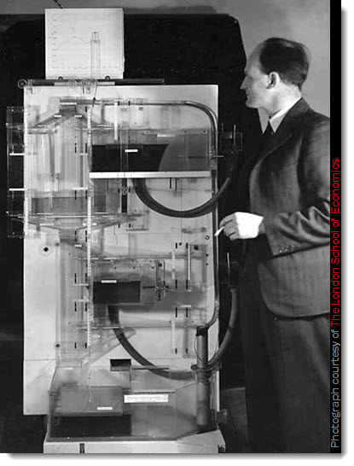
The caricature of hydraulic Keynesianism
Bill Phillips LSE, 1949
Money National Income Analogue Computer
MNIAC

Slide 4
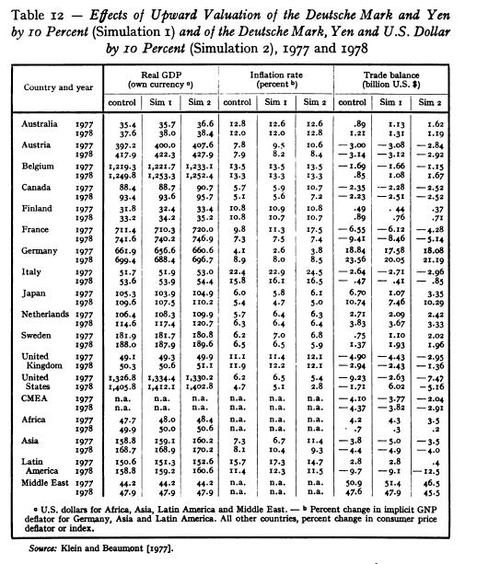
High-Tech the Econometric Matrix of global policy coordination in the 1970s:
the Penn- OECD/UN LINK model

Slide 5
“(T)he ambition of any sociological enquiry must be to go further … it must be to investigate how inflation, understood as the monetary expression of distributional conflict, is ultimately grounded not in error, ignorance or unreason … but rather in on-going changes in social structures and processes. And moreover, once such changes are established as analytically basic, the goal and potential of sociological analysis should then be to show how the actions of rank-and-file employees, union leaders, governments etc are, if not rational in the economist’s sense, still intelligible: that is to say, express a logic which is adequate form the actor’s point of view, in the situation in which he finds himself, and which at the same time is apprehensible by the “outside” observer.” Goldthorpe 195

Slide 6
“in order to understand the relationship between economic quantities in terms of which the problem is defined, one must understand the underlying, generative, relationships between social groupings – and that these will themselves present further “problems” of a kind which are not open to merely technical resolution in the light of economic science.” Goldthorpe, 212
Relationship of quantities
Defined
“problems”
Merely technical
Economic science
epiphenomenal
Relationship of social groupings
Understand
underlying
generative
Sociology
foundational
V.

Slide 7
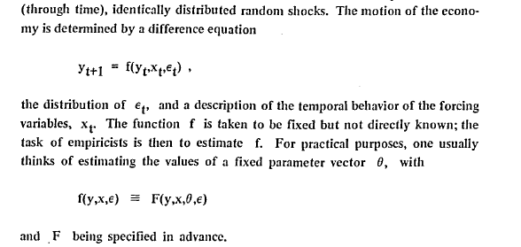
The Lucas Critique of technocracy
The theory of economic policy (Tinbergen)

Slide 8
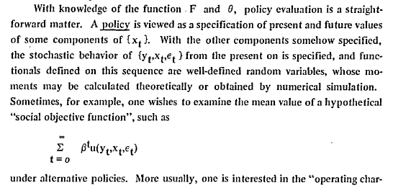

Slide 9
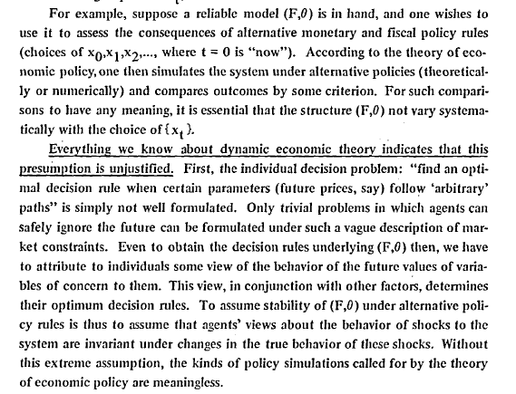

Slide 10
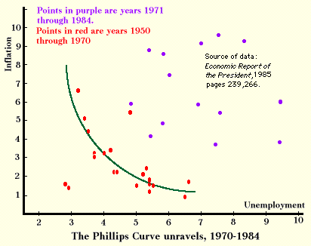

Slide 11
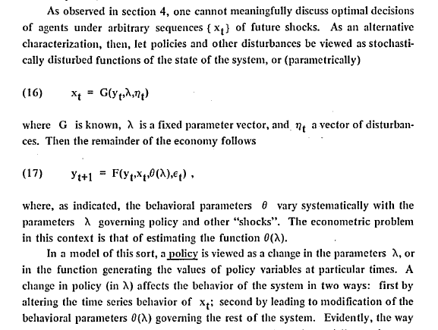

Slide 12
Lucas on the impossibility of “scientifically” arbitrating between rules and authority:
“the preference for “rules versus authority” in economic policy making suggested by this point of view, is not, as I hope is clear, based on any demonstrable optimality properties of rules-in-general (whatever that might mean). There seems to be no theoretical argument ruling out the possibility that (for example) delegating economic decision-making authority to some individual or group might not lead to superior (by some criterion) economic performance than is attainable under some, or all, hypothetical rules … the point is rather that this possibility cannot in principle be substantiated empirically. The only scientific quantitative policy evaluations available to us are comparisons of the consequences of alternative policy rules.”

